Slide 1
CONTEXTUAL NEWS INFORMATION RETRIEVAL
Group members:
Zain Ul Abedin
Annas Israr
Faizan Ahmad
Yaldram Shehzad
Supervisor:
Engr. Muhammad Umer Haroon

Slide 2
Introduction
The name of the project is Contextual News Information Retrieval and is named because it will extract the online information related to news.
This project is for those that are linked with news research including most of analysts, anchors and reporters.
It is a Web based project and it will be compatible to all web browsers and accessible to all users.

Slide 3
Objectives
This project will assist those that are linked with news research including most of analysts, anchors, reporters.
This project will retrieve valid and authentic news information from sites, articles and blogs according to user’s context(searched query).
This project will then manage the gathered information to support the user in an efficient way.

Slide 4
Social Benefits
This project will help the user in research needed before presenting any report analysis or presentations.
This project will help in search of any valid and authentic news from different sites, articles and blogs.
This project will save the time in overall research process by retrieving information in minutes instead of hours.
This project will reduce the effort in research by systematically extracting the information from different sources.

Slide 5
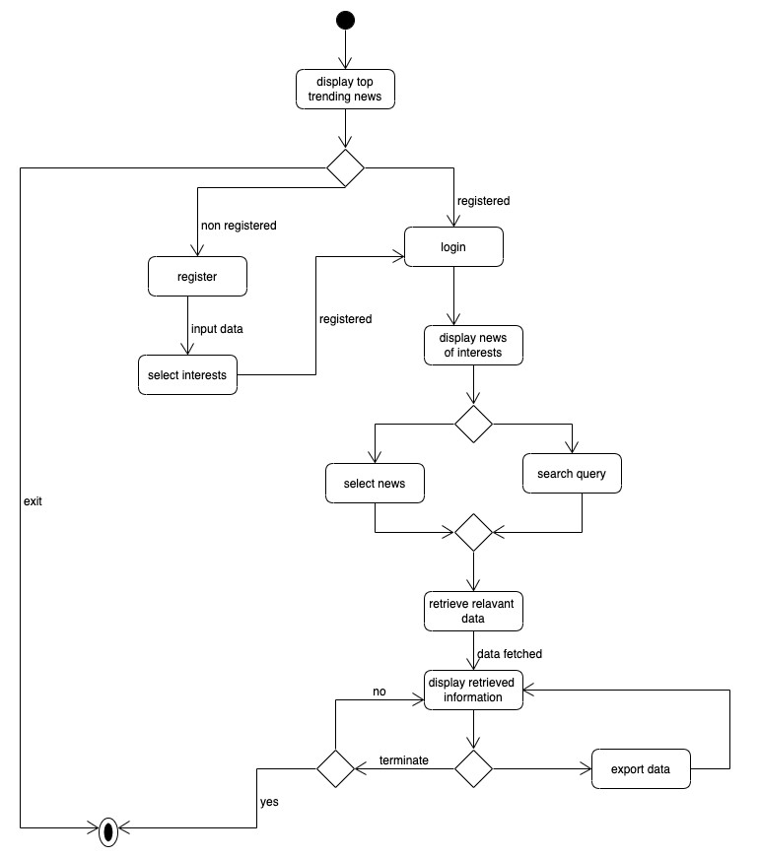
Flowchart

Slide 6
Cost Estimation
Serial no. | Component | Cost (1 Month) | Total cost (3 Months)
1. | Domain name | 2000 | 2000
2. | Web hosting | 10430 | 31290
3. | Octoparse Scrapping Tool | 11600 | 34800
4. | Miscellaneous | 2800 | 8400
 | Total |  | 76490

